Slide 1
Alzheimer’s Disease GWAS Analysis
BMIN 5030 – Data Science
Taha Iqbal

Slide 2
Project Overview
Overview: Analyze ADC10 GWAS summary statistics and generate Manhattan plots and QQ plots to visualize results. Use FUMA platform to annotate and map these associations to their genes and determine the role and pathways implicated for these genes.
Methods:
Use SNPTESTv2.5.6 to generate GWAS summary results using ADC10 dataset
ADC10: 8,214 samples
NIA ADC cohort subjects evaluated by the clinical and neuropathology core
Data collection coordinated by NACC
Use R to clean data/generate Manhattan and QQ plots
Use FUMA to annotate and get in-depth genomic results
Notes:
The data used is ADC10 which is from the dataset of ADC1-10. This NIA ADC cohort includes subjects evaluated by the clinical and neuropathology core. Data collection is coordinated by the National Alzheimer's Coordinating Center (NAAC). NAAC coordinates collection of phenotypes from ADCs, cleans all data, coordinates implementation of Alzheimer's definitions cases and controls, and collection of samples.

Slide 3
Introduction
Alzheimer’s Disease is a progressive neurodegenerative disease associated with cognitive decline. 13% people over age 65 and 45% over age 85 are estimated to have AD
AD can be classified into 2 categories, Late-onset AD (95%) and Early-onset AD (5~). EOAD is known to have a significant genomic component with APP, PSEN1, PSEN2 as main disease-causing genes.
For LOAD one of the most significant genetic risk factors are the different alleles of APOE. Gene polymorphisms such as e4 and e2 are implicated
Notes:
I hope to reproduce results shown in literature, as well as get statistically significant SNP associations

Slide 4
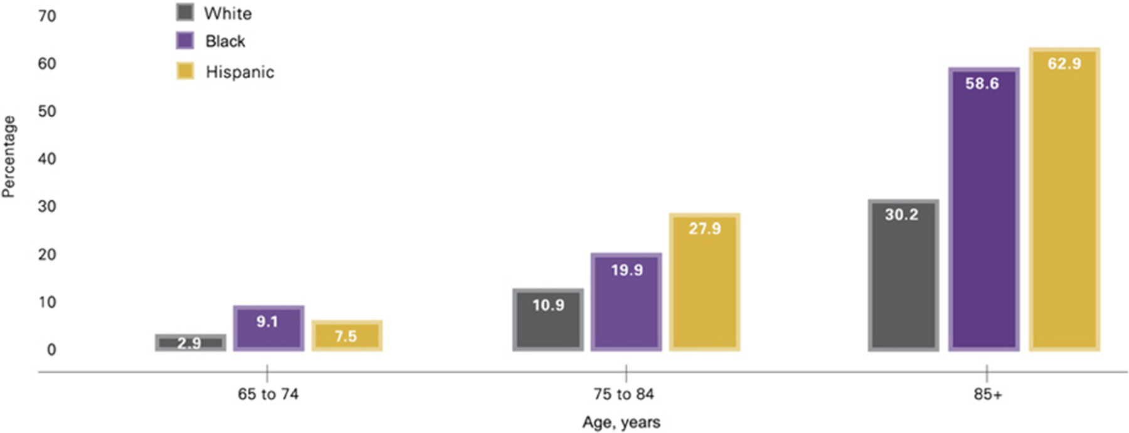
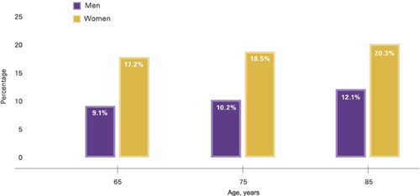
AD Prevalence
Proportion of people aged 65 or older with AD
Estimated lifetime risk for AD by age and sex
Thies, W. and Bleiler, L. (2013), 2013 Alzheimer's disease facts and figures. Alzheimer's & Dementia, 9: 208-245

Slide 5
GWAS analysis package
PLINK https://zzz.bwh.harvard.edu/plink/
SNPTEST https://www.well.ox.ac.uk/~gav/snptest/
Metal http://csg.sph.umich.edu/abecasis/metal/
Linux data management commands
Notes:
PLINK is a open-source Whole genome data analysis toolset. Out of the 3 I’m pretty sure it’s the most used. It’s used for the analysis of genotype/phenotypic data. It can also be used to change file formats. etc
SNPTEST is a command line tool for the analysis of single SNP association in genome-wide studies.

Slide 6
GWAS Data Structure and Workflow Review
Missing
Relatedness
LD
HWE
MAF
Population
Sex discrepancy
QC
imputation
Phase
QC
Cleaned genotype
Raw genotye data
Imputation
Imputed DATA
Qced imputed DATA
Post impute QC
SNPTEST
R
FUMA
Start here
GWAS analysis
SNPTEST Output
Clean data / Generate plots
Functional Annotation

Slide 7
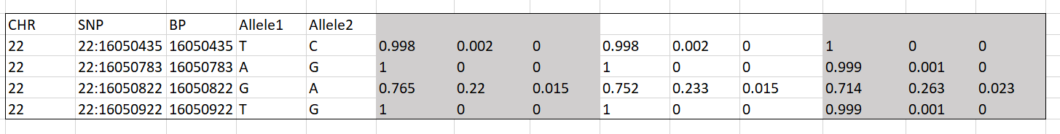
Data structure
Input Data: .gen file + .cov file
.gen file
Native text genotype file format for Oxford statistical genetics tools, such as IMPUTE2 and SNPTEST
A text file with no header line, and one line per variant with either 3N+5 or 3N+6 fields where N is the number of samples. Each line stores information for a single SNP.
From the 7th column, each subsequent triplet of values indicate the likehoods of homozygote of A1, heterozygote and homozygote of A2

Slide 8
Covar file for SNPTEST:
The sample order in the covar file should be consistent with those in .gen file
The 1st line is the header, and the 2nd line is the specified variable types (C: Continuous; B : Binary [outcome/phenotype]; D: Dichotomous [covariate])
ID_1 | ID_2 | missing | omit | pc1 | pc2 | pc3 | aaoaae | aaoaae2 | apoe_1 | apoe_2 | apoe2dose | apoe4dose | age | sex | status
0 | 0 | 0 | D | C | C | C | C | C | D | D | D | D | C | D | B
ADC1_NACC548317_08AD7682 | NACC548317_08AD7682 | 0 | 0 | 0.0062 | 0.0157 | -0.0064 | 67 | 67 | 3 | 4 | 0 | 1 | 67 | 1 | 1
ADC1_NACC083453_08AD7690 | NACC083453_08AD7690 | 0 | 0 | 0.0081 | 0.0113 | 0.0067 | 74 | 74 | 3 | 4 | 0 | 1 | 74 | 1 | 1
ADC1_NACC189109_08AD7701 | NACC189109_08AD7701 | 0 | 0 | 0.011 | -0.0271 | -0.0309 | 66 | 66 | 4 | 4 | 0 | 2 | 66 | 1 | 1
ADC1_NACC128317_08AD7714 | NACC128317_08AD7714 | 0 | 0 | 0.0036 | 0.0149 | 0.0278 | 67 | 67 | 3 | 4 | 0 | 1 | 67 | 1 | 1
ADC1_NACC132768_08AD7730 | NACC132768_08AD7730 | 0 | 0 | 0.0032 | -0.0158 | -0.0075 | 61 | 61 | 3 | 4 | 0 | 1 | 61 | 1 | 1
ADC1_NACC654060_08AD7739 | NACC654060_08AD7739 | 0 | 0 | 0.008 | -0.0341 | -0.0229 | 74 | 74 | 3 | 3 | 0 | 0 | 74 | 2 | 1
ADC1_NACC390465_08AD7753 | NACC390465_08AD7753 | 0 | 0 | 0.0082 | 0.0093 | 0.0211 | 94 | 94 | 3 | 3 | 0 | 0 | 94 | 2 | 1
ADC1_NACC194467_08AD7762 | NACC194467_08AD7762 | 0 | 0 | 0.0017 | 0.0195 | -0.0053 | 76 | 76 | 3 | 3 | 0 | 0 | 76 | 1 | 1

Slide 9
Output from snptest (part of)
alternate_ids | rsid | chromosome | position | alleleA | alleleB | index | average_maximum_posterior_call | hom_OR_upper | all_OR | all_OR_lower | all_OR_upper | frequentist_add_pvalue | frequentist_add_info | frequentist_add_beta_1 | frequentist_add_se_1
22 | 22:16050435 | NA | 16050435 | T | C | 1 | 0.998616 | NA | 0.597798 | 0.052765 | 6.77272 | NA | NA | NA | NA
22 | 22:16050783 | NA | 16050783 | A | G | 2 | 0.999714 | NA | 0.934528 | 0.002751 | 317.427 | NA | NA | NA | NA
22 | 22:16050822 | NA | 16050822 | G | A | 3 | 0.728671 | 2.0663 | 0.995115 | 0.815575 | 1.21418 | NA | NA | NA | NA
22 | 22:16050922 | NA | 16050922 | T | G | 4 | 0.999817 | NA | 1.03182 | 0.000592 | 1798.21 | NA | NA | NA | NA
22 | 22:16050984 | NA | 16050984 | C | G | 5 | 0.999843 | NA | 1.07074 | 0.000315 | 3636.86 | NA | NA | NA | NA
22 | 22:16051099 | NA | 16051099 | G | T | 6 | 0.999962 | NA | 1.83949 | 6.71E-09 | 5.04E+08 | NA | NA | NA | NA
22 | 22:16054713 | NA | 16054713 | C | T | 42 | 0.964541 | 1.61412 | 0.950976 | 1.60079 | 0.583907 | 0.583907 | 0.116481 | -0.434153 | 0.792702
22 | 22:16074795 | NA | 16056801 | G | T | 142 | 0.975471 | 2.18218 | 1.12568 | 2.18018 | 0.581213 | 0.439454 | 0.145794 | 0.66722 | 0.863037

Slide 10
SNPTEST Commands
SNPTEST
:$ snptest
-data genfile/chr22.gen.gz Covar/adc10.covar.snptest.txt
-missing_code NA,-9
-hwe
-frequentist 1
-method score
-pheno status
-cov_names pc1 pc2 pc3
-exclude_samples_where omit=1
-o result/snptest/model1/chr22.out
When running snptest, it will check the samples, covariates type and distribution, etc.
Notes:
-frequentist I – additive model, The output file will have a column for each test that contains –value for the test as well as estimates of the motel perimeters (betas) and standard errors
-pheno specifies which phenotype you wish to test (in this case its binary of 0 1)

Slide 11
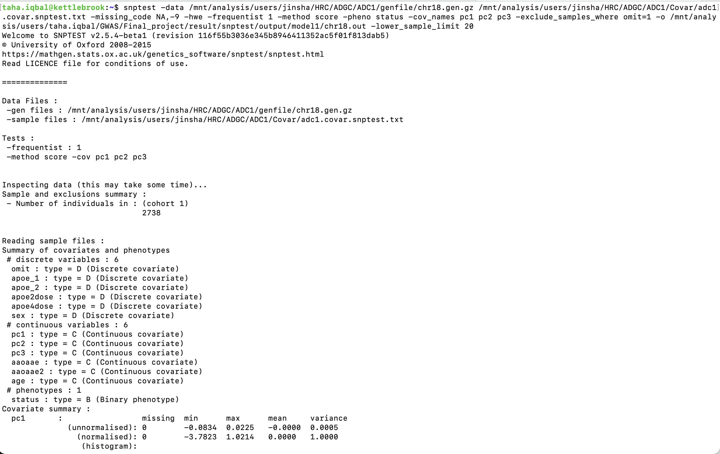

Slide 12
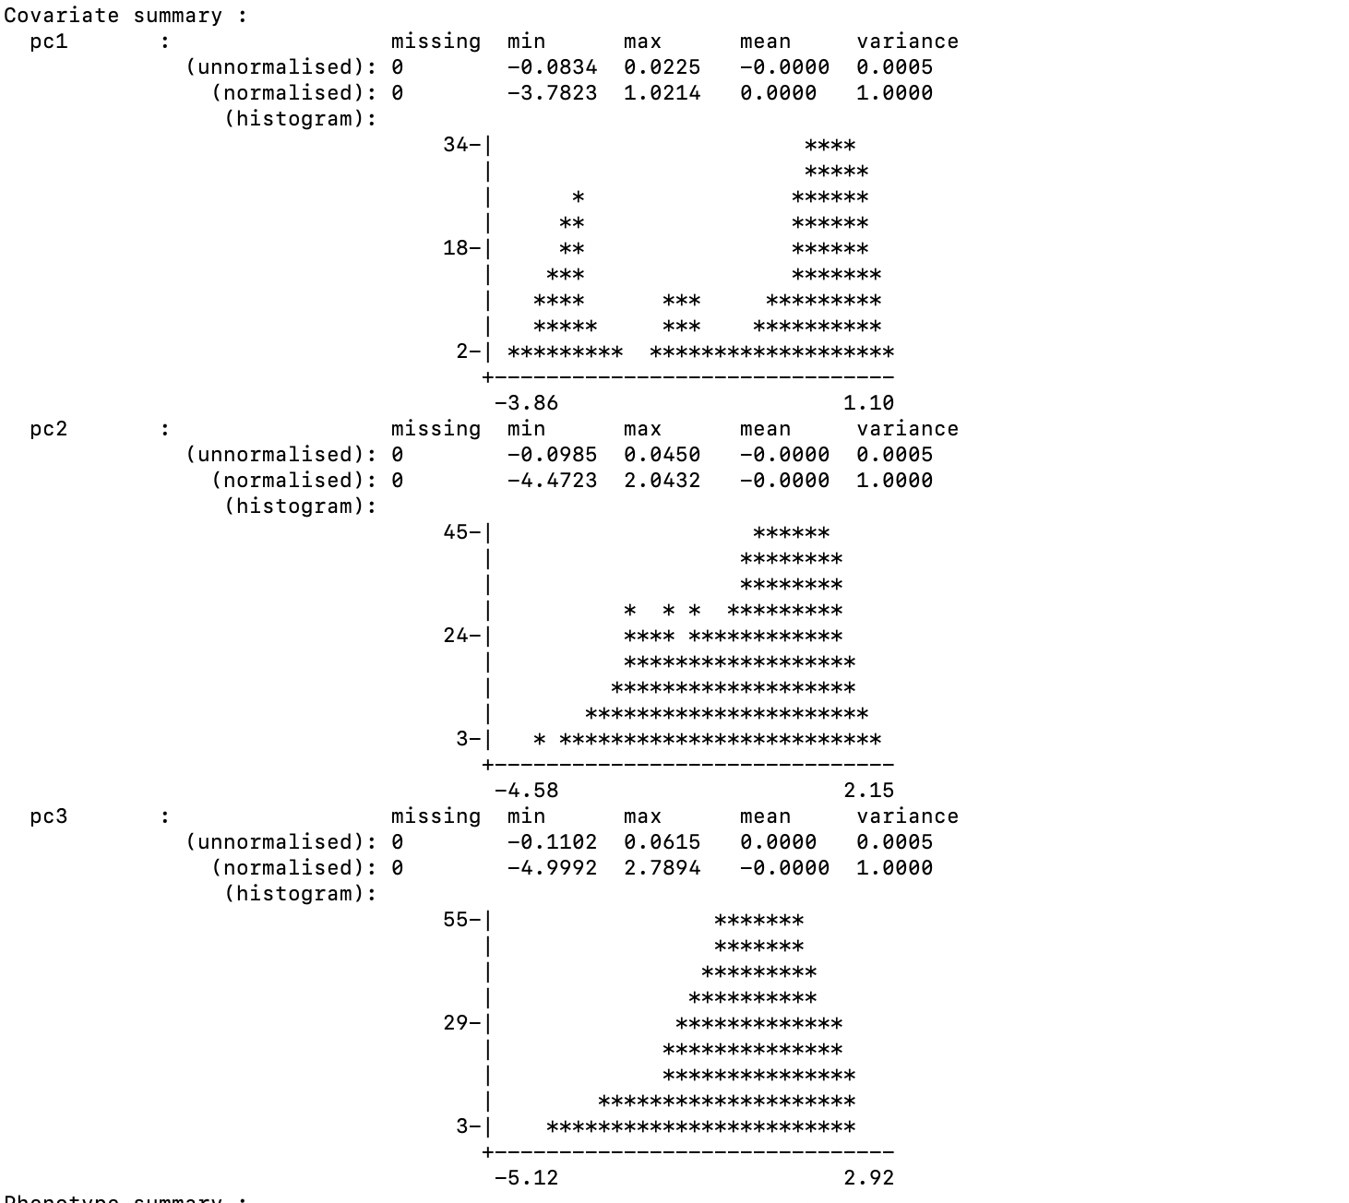

Slide 13
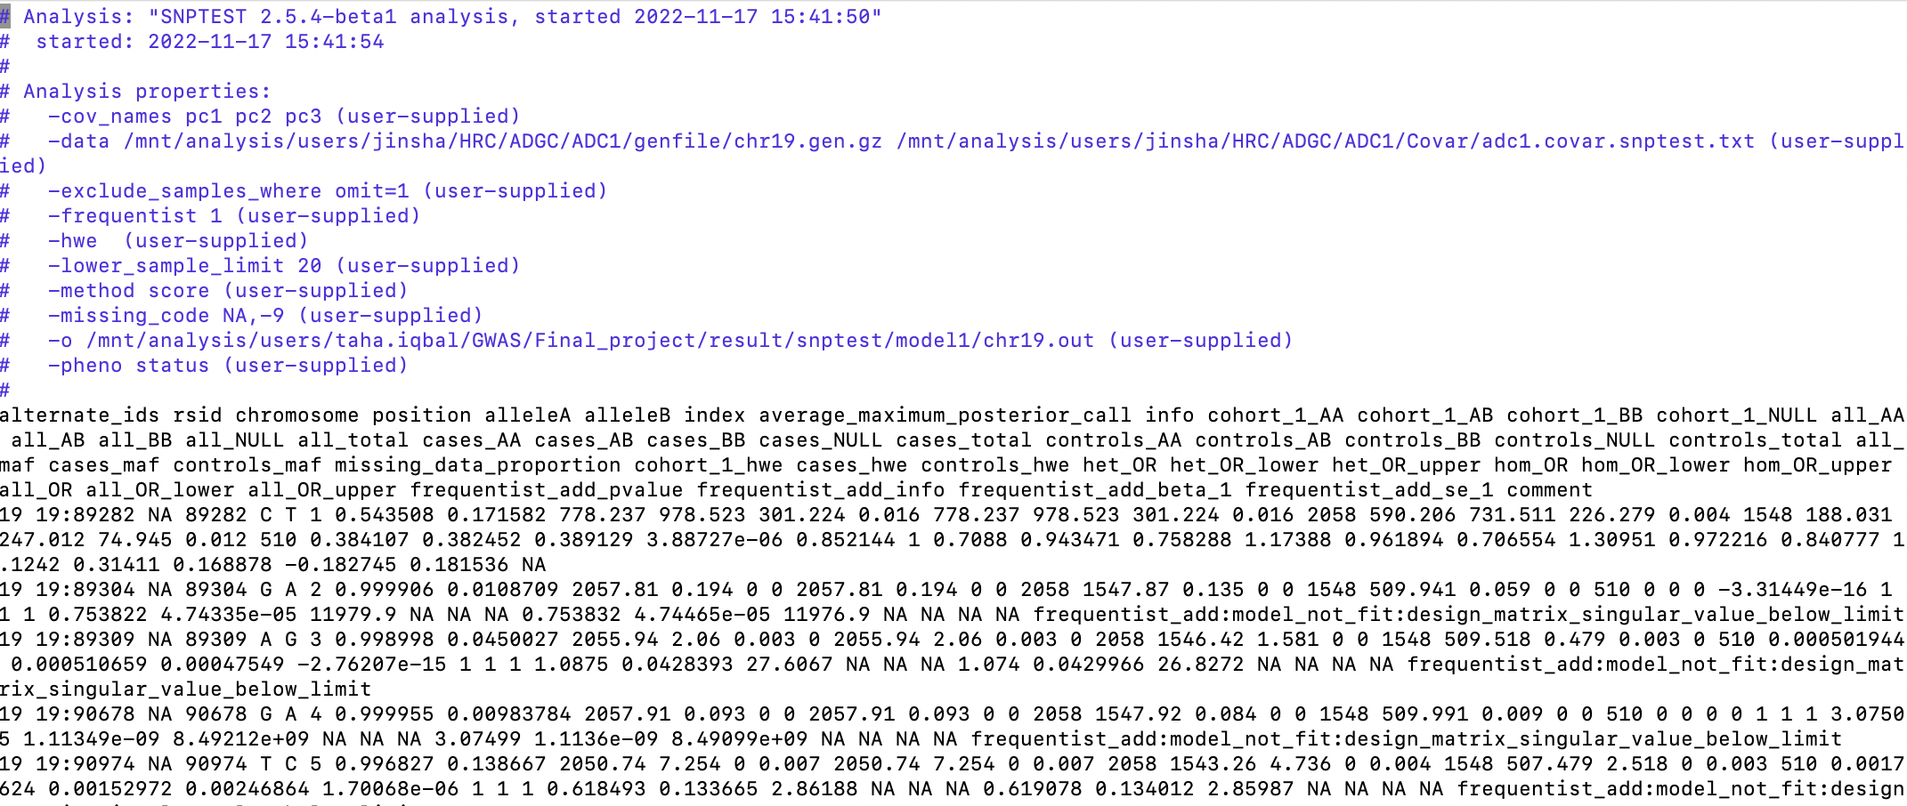
SNPTEST output

Slide 14
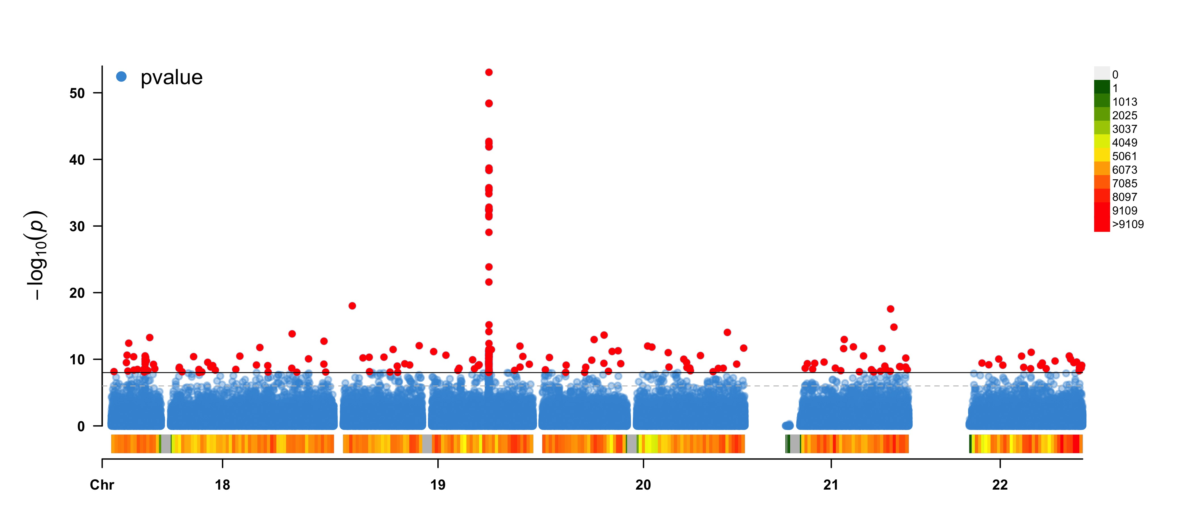
Current Results- Manhattan Plot
APOE Region

Slide 15
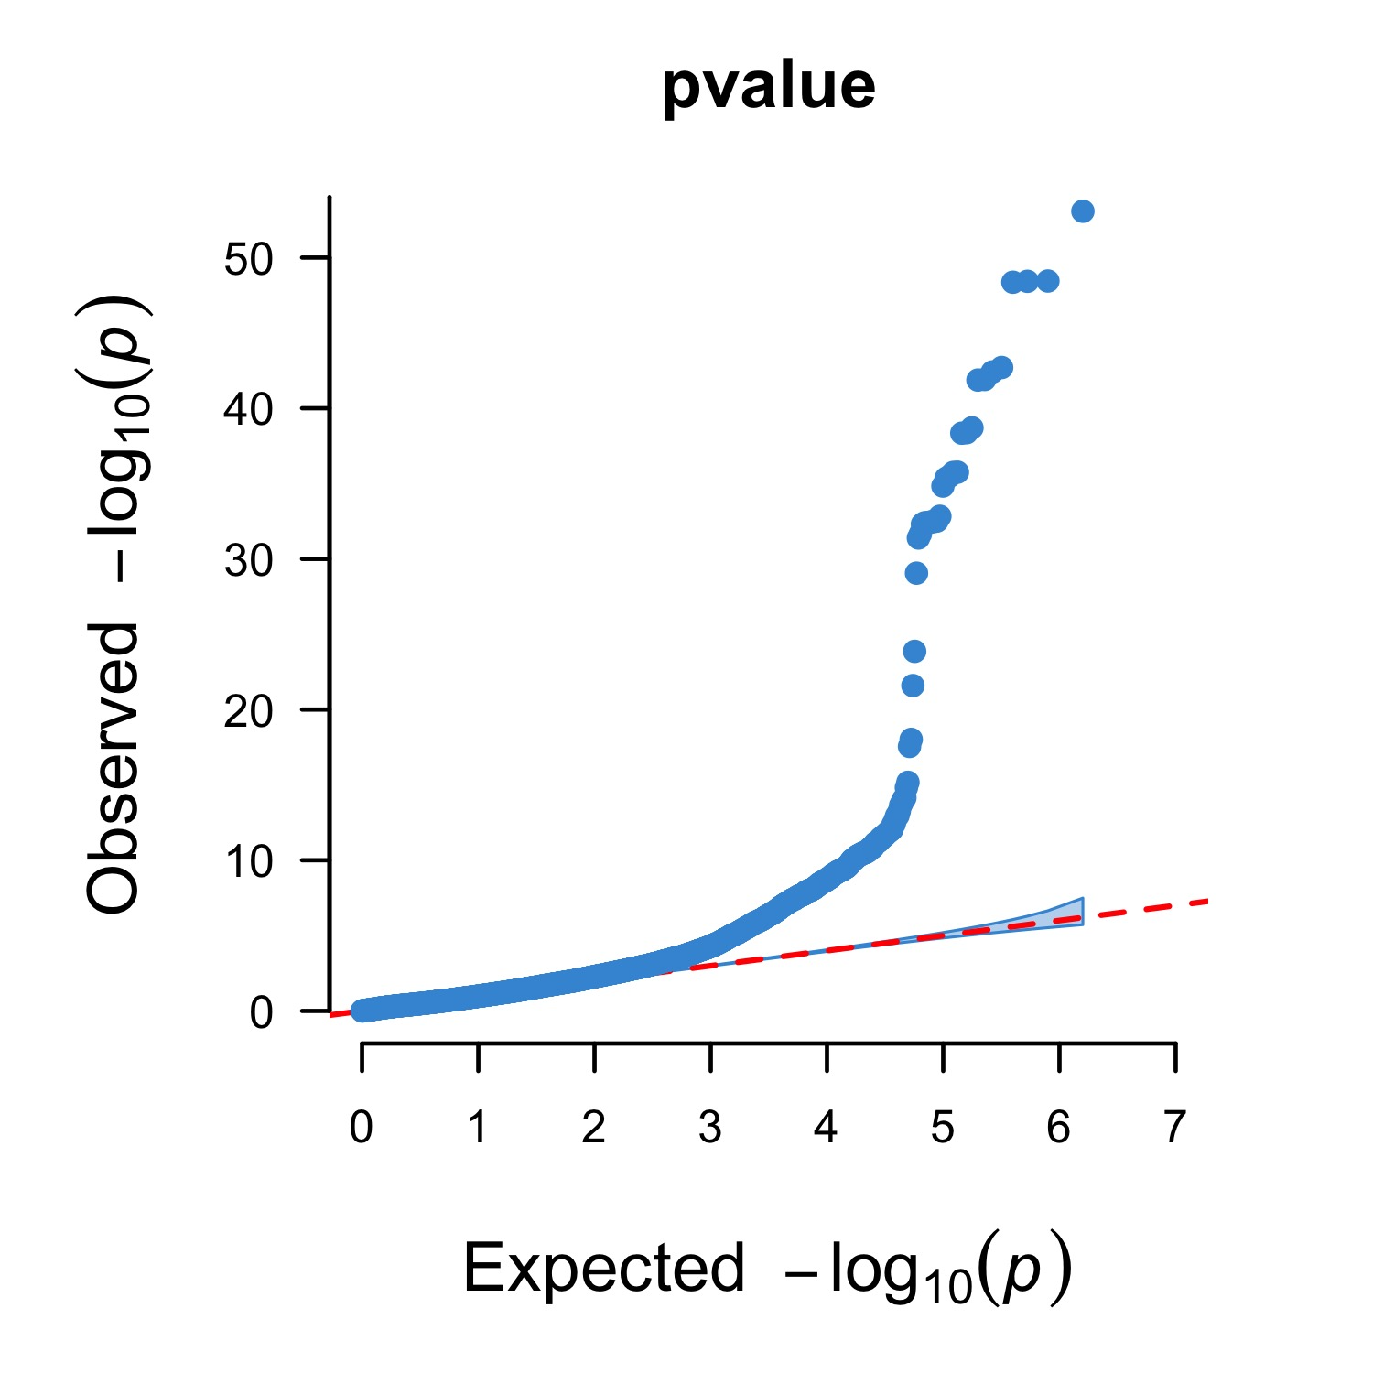
Current Results- QQ Plot
Notes:
QQ plot (quantile-quantile) plot is a probability plot, which essentially compares 2 probability distributions by plotting their quantiles against each other. If the 2 distributions being compared are identical, it will follow the dotted pline, and be within the gray shaded region. For GWAS interpretation, it is a graphical representation of the deviation of observed P values from the null hypothesis. The observed P-values are plotted from largest to smallest and plotted against the expected values.
If observed P values are clearly more significant than expected under the null hypothesis, points will move towards the y-axis. As we see here, there are clearly significant p-value SNPs than the expectation.

Slide 16
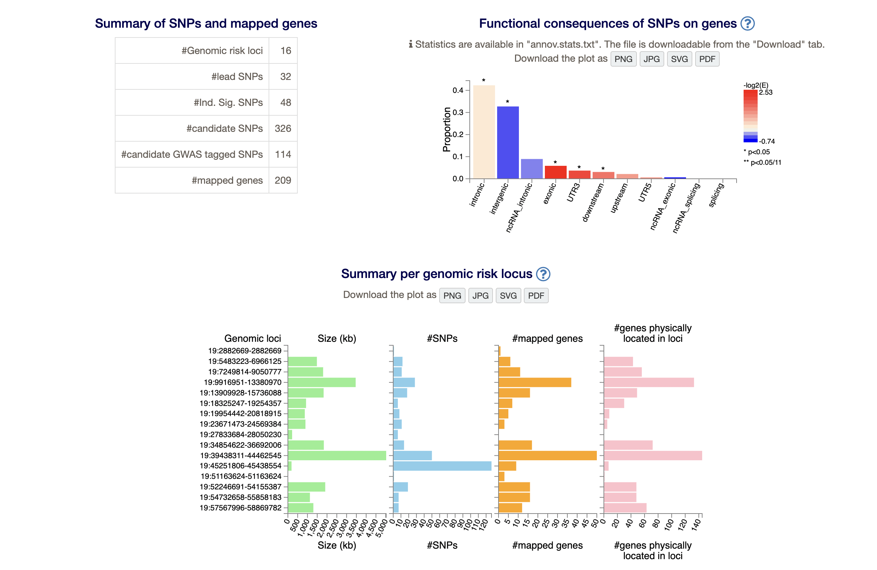
FUMA Results

Slide 17
Building upon Gwas Analysis: Meta analysis
Meta-analysis of genome-wide association summary statistics
Appropriate when data from the individual studies cannot be analyzed together because of differences in ethnicity, phenotype distribution, gender
Metal is a computationally efficient tool for meta-analysis of genome-wide association scans and allow analyses of very large data sets and to support a variety of input file formats

Slide 18
References
Marchini, J., Howie, B. Genotype imputation for genome-wide association studies. Nat Rev Genet 11, 499–511 (2010). https://doi.org/10.1038/nrg2796
Alzheimer's Association, William Thies, and Laura Bleiler. "2013 Alzheimer's disease facts and figures." Alzheimer's & dementia 9.2 (2013): 208-245.
Thies, W. and Bleiler, L. (2013), 2013 Alzheimer's disease facts and figures. Alzheimer's & Dementia, 9: 208-245. https://doi.org/10.1016/j.jalz.2013.02.003
Marchini, Jonathan. "SNPTEST v2 Technical Details." (2010).

